Slide 1
Unit 2 :
Logical Database Design
Databases
1

Slide 2
UNIT 2: LOGICAL DESIGN OF DATABASES
Data model _
The representation of the problem : the E/R
2.1 Entities
2.2 Attributes and types
2.3 Relationships
2.4 Cardinality
2.5 Weakness
The expanded E/R model .
Construction of an E/R
The model relational
5.1 Characteristics of a relationship .
5.2 Restrictions
5.3 Primary keys and foreign keys
5.4 Integrity Referential
5.5 Scheme representation _ relational
5.6 Passage from the E/R diagram to the model relational .
Normalization .
6.1 Dependencies functional
6.2 Forms normal
2

Slide 3
6. The relational model
The relational model is the most appropriate, currently, to represent the structure of a database. This is due to:
It is a simple, powerful and flexible model for designing a database.
It has a mathematical basis in relational algebra. Any operation on elements of the relational model derives from an operation of relational algebra.
Its basis in relational algebra has facilitated the construction of the SQL language to manipulate data.
Most DBMSs are relational, they are based on this model.
Recommended blog from El Baul del Programmer
3

Slide 4
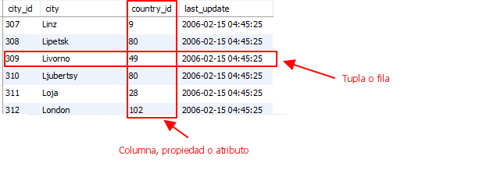
6.1 Characteristics of a relationship
The main element of the relational model is the RELATIONSHIP.
A relationship is a table where each element of the relationship is a row and is called a tuple of the relationship and each property, attribute or characteristic of the elements is a column .
You should not confuse the concept of relationship in the relational model with the concept of relationship in the E/R model
4

Slide 5
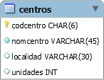
6.1 Characteristics of a relationship
The set of values that a column can take is called its domain. A domain can be:
General: if the values can be all those existing within the data type corresponding to the column.
Restricted: If it can only take values within a range of a general domain, for example, real numbers between 0 and 10.
5

Slide 6
6.2 Restrictions of the relational model
Constraints inherent to the model (established by the model itself):
There cannot be two tuples or rows that have the same content in all their columns.
No column that is a primary key (user constraint) is nullable.
No column that is a primary key allows repeated values in tuples.
No column that is an alternative key allows repeated values in tuples.
6

Slide 7
6.2 Restrictions of the relational model
User restrictions (the relational model allows the user to set them):
Primary key (PRIMARY KEY)
Uniqueness or alternative key (UNIQUE)
Mandatory (NOT NULL)
Foreign key (FOREIGN KEY)
Verification or check (CHECK)
Assertions or assertions (ASSERTION)
Triggers (TRIGGER)
Recommended Blog of the Programmer's Trunk
7

Slide 8

6.3 Primary and foreign keys
Primary or primary key (PRIMARY KEY)
It is a set of attributes or columns that uniquely identify each tuple in a relationship (each row in a table).
Primary key must be declared in any table, although it is not mandatory to do so.
Only one primary key can be defined in a table and it must be, within the columns that can be used to identify each tuple, the column or set of columns that is considered best to uniquely identify each tuple or element of the table. .
The inherent restrictions discussed above are established on the primary keys.
8

Slide 9
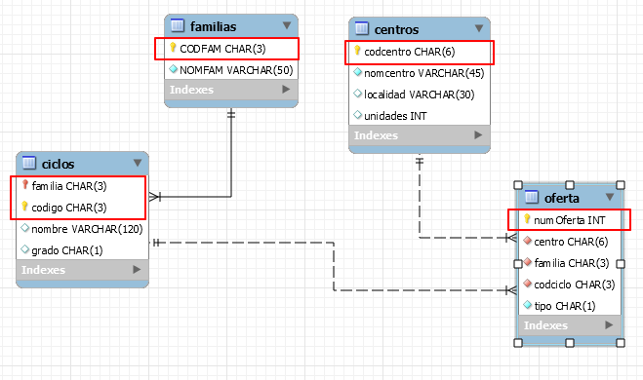
6.3 Primary and foreign keys
Primary or primary key (PRIMARY KEY)
9

Slide 10
6.3 Primary and foreign keys
Foreign key (FOREIGN KEY)
It serves to indicate that one or more attributes that form a foreign key in a table (secondary table in the relationship, reference) are related to one or more attributes of another table (parent in the relationship, referenced) that form a primary key or alternative key in that other table.
For example, if we have a table COUNTRY that contains data for all countries in the world and a table CITY that contains data for cities in the world, there may be a foreign key relationship between CITY (child table) with COUNTRY (parent table) to control the country to which each city belongs.
10

Slide 11
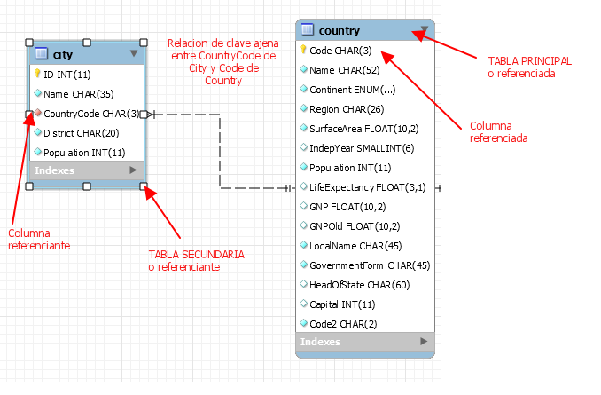
6.3 Primary and foreign keys
11

Slide 12
6.4 Referential Integrity
integrity constraints _ _ referential are the that allow that the DBMS controls inconsistencies between data loaded in the foreign key and the data existing in the primary key of the main table .
integrity constraints _ _ referential act when :
It is inserted a new row in table secondary .
foreign key in the table is modified secondary .
It is deleted a row in the main table .
primary key in the main table is modified .
12

Slide 13
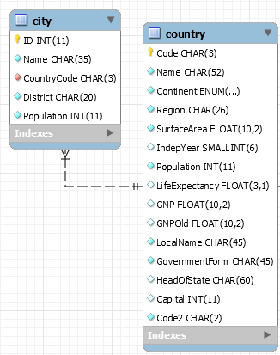
6.4 Referential Integrity
When a new row is inserted into the child table.
When inserting a new city, it would be checked that the CountryCode of the new city is loaded in the Code of some Country. If it is not, the insertion is rejected.
13

Slide 14
6.4 Referential Integrity
When modifying a foreign key in a row in the child table.
CountryCode is checked to exist in the primary key Code of the main table COUNTRY. If it does not exist, the modification is rejected and the row with the previous value remains.
14

Slide 15
5.4 Referential Integrity
When deleting a row in the main table.
Cascade Delete (BC) : If a country is deleted, all cities in the country are deleted.
Restricted Delete (BR): If you are trying to delete a country and there are cities of that country in the CITY table, the deletion is not allowed.
Deletion with nulling (BN): If you try to delete a country and there are cities of that country in the CITY table, the country is deleted and in the foreign key column (countrycode) of CITY of all the cities of that country, NULL is loaded.
Deletion with default value (BD): If you try to delete a country and there are cities of that country in the CITY table, the country is deleted and in the foreign key column (countrycode) of CITY of all the cities of that country, a default value is loaded.
15

Slide 16
5.4 Referential Integrity
When modifying the primary key field in a row of the main table.
Cascade Modification (MC) : If the code of a country is modified, the countrycode of all cities in the country is modified.
Restricted Modification (MR): If you are trying to modify the code of a country and there are cities of that country in the CITY table, the modification is not allowed.
Modification with nulling (MN): If you try to modify the code of a country and there are cities of that country in the CITY table, NULL is loaded in the foreign key column (countrycode) of CITY of all the cities of that country .
Modification with default value (MD): If you try to modify the code of a country and there are cities from that country in the CITY table, the country is modified and in the foreign key column (countrycode) of CITY of all the cities in that country, a default value is loaded.
16

Slide 17
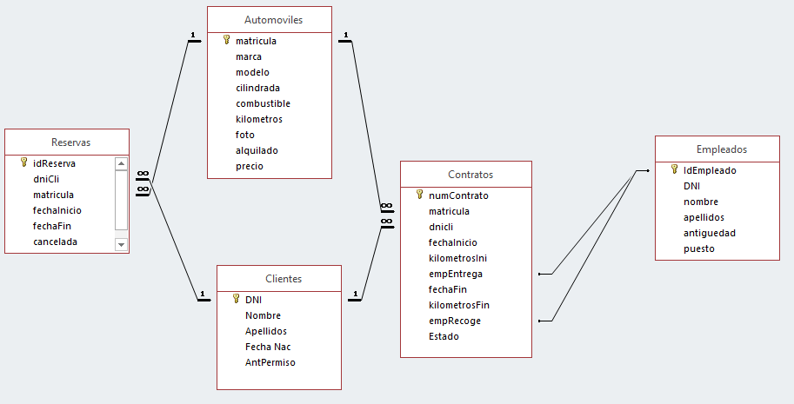
5.5 Representation of the relational schema
Scheme type 1
17

Slide 18
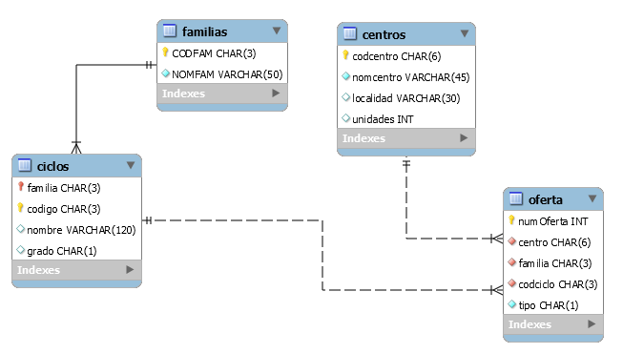
5.5 Representation of the relational schema
Scheme type 2
18

Slide 19
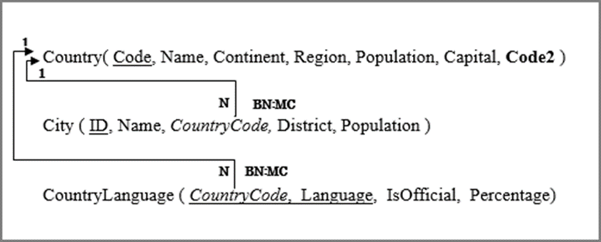
5.5 Representation of the relational schema
Scheme type 3
19

Slide 20
5.5 Representation of the relational schema
Scheme type 3
It is a graph where :
Each node or element It represents a table or relationship with everyone their attributes .
They are represented foreign keys _ through arrows _ _ directed between the foreign key and the table where is the primary key related .
Each node in the graph ( table ) is represented , if is possible , with a text line . _ This line contains in letters capitalize the name of the table and then , in parentheses , the names of the attributes or columns as follows :
If an attribute is primary key is represented underlined .
If an attribute The alternative key is represented in bold . In the course we will can represent it double underlined .
If an attribute can take values null , is represented by an asterisk at the end of the attribute name .
If an attribute It is a foreign key and is represented in letters. italics . We will represent it in quotes .
20

Slide 21
5.5 Representation of the relational schema
Scheme type 3
EMPLOYEES ( numemmp , name , surname , ID , ncat , salary , date , phone number *)
EMPLOYEES ( name , name , surname , ID , “ ncat ”, salary , date , phone number *)
If this It
The line describes a board called EMPLOYEES.
The EMPLOYEES table contains the columns number , name , surname , ID , ncat , date and phone number .
primary key is numep .
The attribute ID It is alternative key .
The attribute phone admits values null .
The attribute ncat is a foreign key ( although it has not been represented with what table and primary key is related ).
21

Slide 22
5.5 Representation of the relational schema
Scheme type 3
Representation of foreign keys
If an attribute It is a foreign key and is represented in letters. italics .
To represent the key with which this related to the foreign key , it is traced a arrow directed from the name of the foreign key to table name _ _ that contains the related key .
At the origin of the arrow there must be write the deletion and modification restrictions , yes _ is that are going to be established .
in the relationship has to represent cardinality . _ If the type is 1:N, 1 will be written at the end of the arrow , it is i.e. in the main table and N will be written at the origin of the arrow .
in the model relational is not allowed represent N:M cardinalities , only 1:1 and 1 :N
22

Slide 23
5.5 Representation of the relational schema
Scheme type 3
Representation of foreign keys
In the CountryLanguage table, the CountryCode column is a foreign key and is related to the primary key of the Country table.
For each row in Country there can be many rows in CountryLanguage.
There is a deletion restriction set to null in this foreign key, so when a country is deleted, the CountryCode of CountryLanguage that has that country associated with it will be set to Null.
There is a cascading modification restriction in that foreign key, so if the code of a country is modified, that code is modified in all the languages of the country.
23

Slide 24
5.5 Representation of the relational schema
Exercise
Represents the scheme relational corresponding to a database _ about the network of hostels on the Camino de Santiago del Norte.
Of each hostel will register his name , address , location and km that missing to the final destination (Santiago de Compostela ). exist hostels with the same name generic ( Pilgrim 's Hostel , for example ).
The hostels are municipal property , they belong to City Councils . A certain City hall can have several _ hostels .
Of each City hall must know his name , address , telephone number and URL of your website.
In the hostels they spend the night pilgrims whose card number ( unique ) is registered , their _ _ name and nationality .
The entry date of each must be recorded . pilgrim in the hostel corresponding .
24

Slide 25

5.6.- Step from the E/R diagram to the relational diagram
Every entity, whatever its type, is transformed into a table that contains the same attributes of the entity, except the multivalued ones.
25

Slide 26
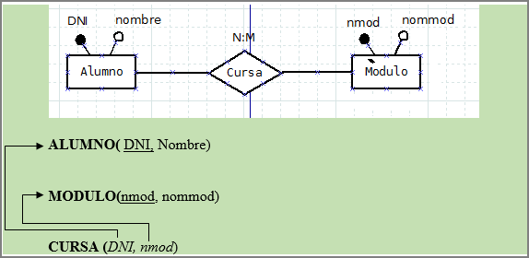
5.6.- Step from the E/R diagram to the relational diagram
Relationships with correspondence type N:M between an entity A and an entity B give rise to a table whose primary key is formed by the concatenation of the primary keys of tables A and B. The table will also have the attributes that are specific to the relationship.
26

Slide 27
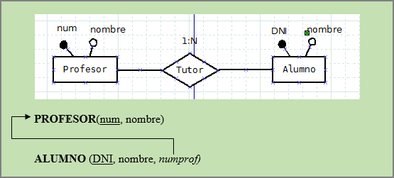
5.6.- Step from the E/R diagram to the relational diagram
, the primary key of the entity with maximum participation 1
27

Slide 28
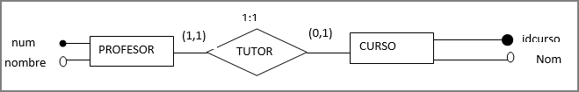

5.6.- Step from the E/R diagram to the relational diagram
A relationship with 1:1 cardinality between two entities A and B presents three cases :
If A's share is (0,1) and B's share is (1,1), B's primary key is propagated to be a foreign key in table A.
If A's share is (1,1) and B's is (1,1), the primary key of any of the two tables is propagated as a foreign key to the other table .
If the participation of both entities is (0,1), it is as the case of the relationships with correspondence type N : M.
28

Slide 29
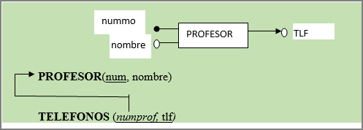
5.6.- Step from the E/R diagram to the relational diagram
A multivalued attribute of an entity gives rise to a table made up of two attributes: the key of the entity of which it is a part and the corresponding attribute, not being multivalued in this new table. The primary key will be the concatenation of the two attributes or a new identifier chosen for that function.
29

Slide 30
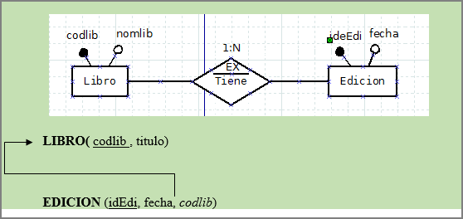
5.6.- Step from the E/R diagram to the relational diagram
A relationship with an existing dependency causes the primary key of the strong entity to be propagated as a foreign key in the table corresponding to the weak entity. The primary key in the table corresponding to the weak entity will be the one indicated for said entity in the ER schema.
30

Slide 31
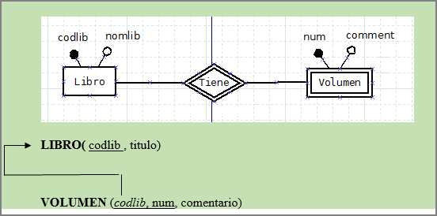
5.6.- Step from the E/R diagram to the relational diagram
A relationship with a dependency on identification causes the primary key of the strong entity to be propagated as a foreign key in the table corresponding to the weak entity. The primary key in the table corresponding to the weak entity will be the concatenation of the propagated foreign key and the weak entity identifier indicated in the ER schema.
31

Slide 32
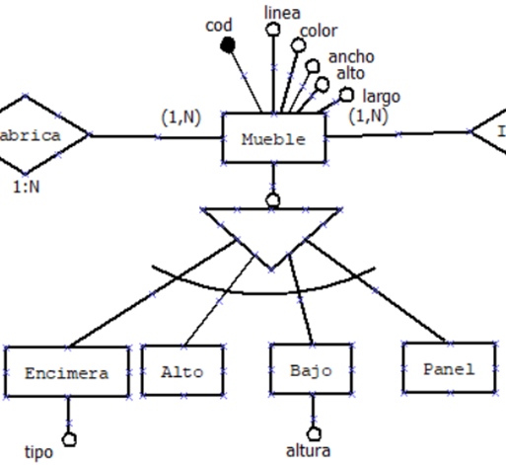
5.6.- Step from the E/R diagram to the relational diagram
When us we found a superclass and various subclasses have several options for transform it into the model relational :
Encompass the superclass and the subclasses in a single table with all the attributes , common and uncommon , of the entities . The table must have a “ Type ” attribute that distinguish between subclasses . Valid only if there are no relationships particulars of the subclasses and whether they are exclusive .
A board by each subclass with attributes own and common . It is only valid for exclusive totals .
A board for the superclass and a for each subclass . Those of the subclass inherit the primary key of the superclass as a foreign key . worth so much for totals as partial as well that overlapping and exclusive .
32

Slide 33
5.6.- Step from the E/R diagram to the relational diagram
Let's look at an example:
Enclose the superclass and subclasses in a single table with all the common and uncommon attributes of the entities. The table must have a “Type” attribute that distinguishes between subclasses. Only valid if there are no particular relationships of the subclasses and if they are exclusive.
Furniture ( cod, line , color, width , height, length, type , height , furniture_class )
33

Slide 34
5.6.- Step from the E/R diagram to the relational diagram
Let's look at an example:
A table for each subclass with its own and common attributes. Only valid for total exclusives.
Countertop ( cod, line , color, width , height, length, type )
Height ( code, line , color, width , height, length)
Low ( cod , line , color, width , height, length, height )
Panel ( code , line , color, width , height, length)
34

Slide 35
5.6.- Step from the E/R diagram to the relational diagram
Let's look at an example:
One table for the superclass and one for each subclass . Those of the subclass inherit the primary key of the superclass as a foreign key. Valid for both total and partial as well as overlapping and exclusive.
Furniture ( code, line , color, width , height, length)
Countertop ( furniture_code , type )
Height ( furniture_code )
Low ( furniture_code , height )
Panel( furniture_code )
35

Slide 36
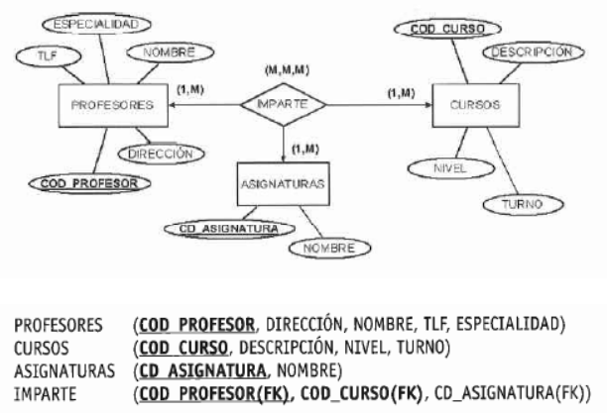
5.6.- Step from the E/R diagram to the relational diagram
Ternary relationships
Each entity becomes a table , as well as the relationship that will contain its own attributes plus the keys of all the entities. The key of the resulting table will be the concatenation of the keys of the entities .
• If the relationship is N:N:N , the key of the resulting table is the union of the keys of the entities it relates. That table will include the attributes of the relationship if any.
36

Slide 37
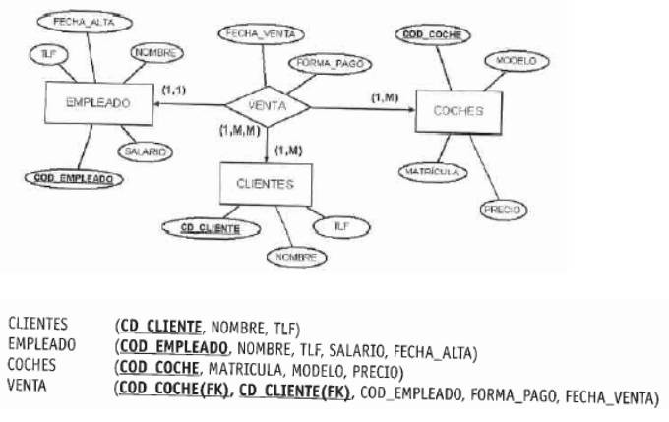
5.6.- Step from the E/R diagram to the relational diagram
Ternary relationships
• If the relationship is 1:N:N , the key of the entity with maximum cardinality 1 does not become part of the key of the resulting table, but is part of the relationship as another attribute (as a foreign key).
37

Slide 38
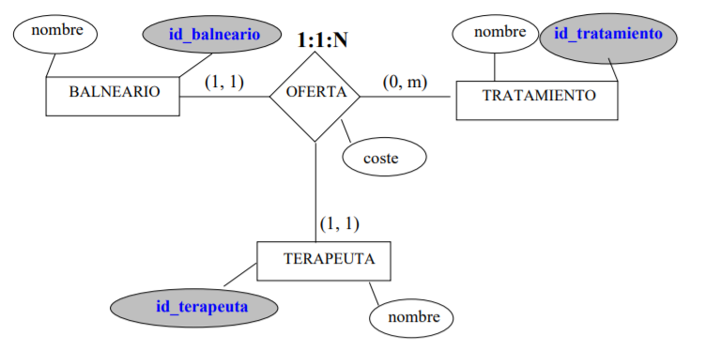
5.6.- Step from the E/R diagram to the relational diagram
Ternary relationships
If the ratio is 1:1:N
The keys of entities with maximum cardinality 1 do not become part of the key of the resulting table, but are propagated and become part of the relationship table as another attribute (as foreign keys); the key of the entity with maximum cardinality N will also be primary of the relationship.
SPA ( spa_id , name)
THERAPIST( therapist_id , name )
TREATMENT ( treatment_id , name)
OFFER( treatment_id (FK) , spa_id (FK), therapist_id (FK), cost)
38

Slide 39
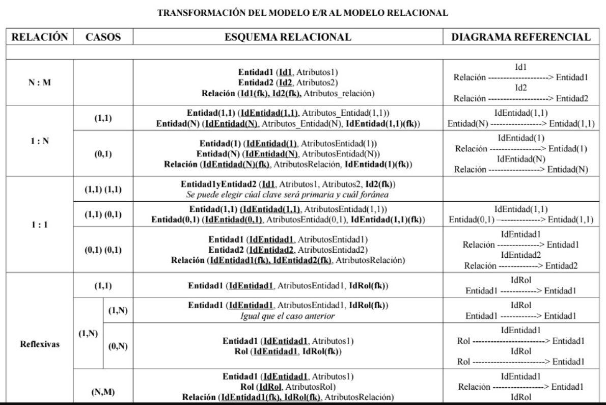
5.6.- Step from the E/R diagram to the relational diagram
39
https://javierjg.es/blog/transformacion-modelo-entidad-relacion-a-modelo-relacional/

Slide 40
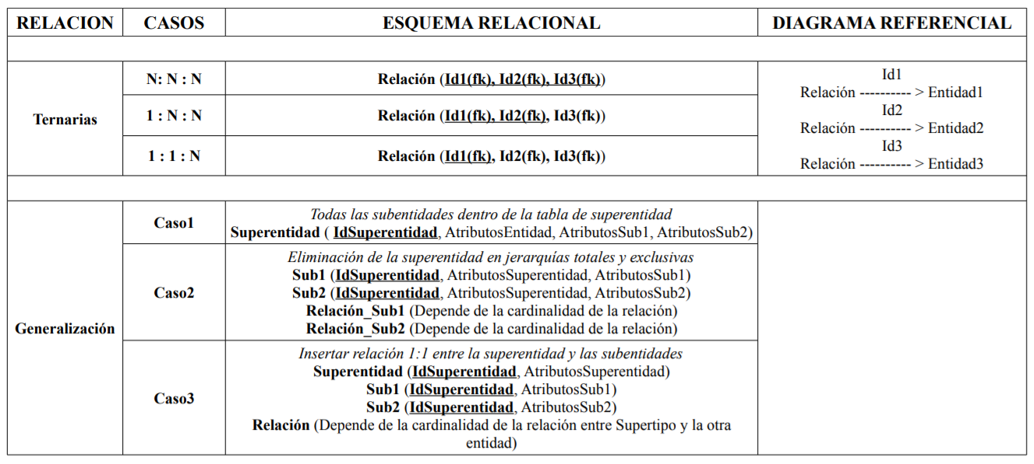
5.6.- Step from the E/R diagram to the relational diagram
For the relational scheme of the previous cases, it is necessary to take into account:
Bold : Key
Bold and underlined : primary key
( fk ): Foreign Key
40
https://javierjg.es/blog/transformacion-modelo-entidad-relacion-a-modelo-relacional/

